Slide 1
OOPs Concepts
Polymorphism

Slide 2
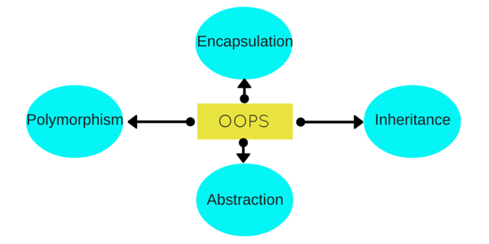
OOPs Concepts
4 primary concepts:
Abstraction
Encapsulation
Inheritence
Polymorphism

Slide 3
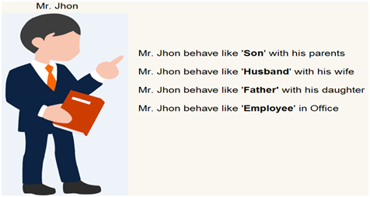
Real Life Example of Polymorphism

Slide 4
Topics to be discussed
What is polymorphism?
Types of Polymorphism
Why polymorphism?
Example of polymorphism

Slide 5
What is polymorphism?
Polymorphism is an object-oriented concept that allows us to create versatile software designs
Versatile: able to adapt or be adapted to many different functions or activities.
Example: versatile writer, a versatile actor etc.,
It is the ability of an object to take on many forms.
A concept by which we can perform single action by different ways.
Polymorphism is derived from 2 Greek words: “poly” means many and “morphs” means forms. So polymorphism means many forms.

Slide 6
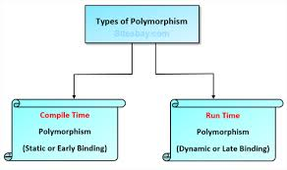
Types of polymorphism
Static(or Compile time) polymorphism: achieved through overloading.
Dynamic(or Run time) polymorphism: achieved through overriding.

Slide 7
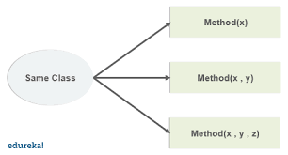
Compile Time Polymorphism
Achieved through overloading.
Overloading: Overloading allows different methods to have the same name, but different signatures where the signature can differ by the number of input parameters or type of input parameters or both.
Advantage: No need to create and remember different names for functions doing the same thing.

Slide 8
Types of Overloading
Method overloading: When there are multiple functions with same name but different parameters then these functions are said to be overloaded.
Operator overloading: Java also provide option to overload operators.
Example: (+) operator.

Slide 9


Overloading Example
Classmate
Best Friend

Slide 10
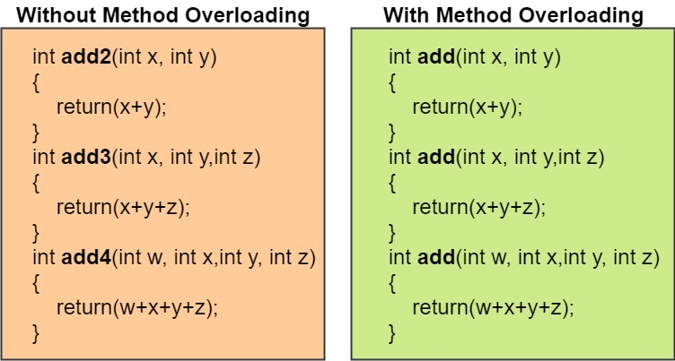
Comparison

Slide 11
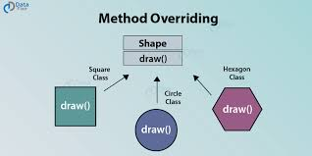
Run time Polymorphism
Achieved through overriding.
Overriding(method overriding): occurs when a derived class has a definition for one of the member functions of the base class. That base function is said to be overridden.
Advantage: Provides multiple implementation of same method and can invoke parent class overridden method using super keyword.

Slide 12


Overriding Example
Mother Cooking
Child Cooking

Slide 13
Why polymorphism?
It provides flexibility in extending the application.
It results in more compact design and code.

Slide 14
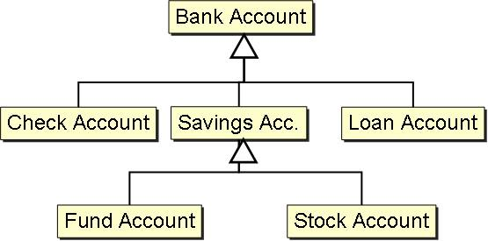
Example

Slide 15


